Slide 1
Order To Cash Case Study
Case Study on SAP ERP Data
Joyline Rencita Dsouza
30/10/2024

Slide 2

Order To Cash Case Study
Case Study on SAP ERP
Joyline Rencita Dsouza
30.10.2024

Slide 3
Table of Contents
01
Introduction to Celonis Platform
02
Analysis on Order to Cash Case Study
03
Demonstration
04
Results and Conclusions from the case study

Slide 4
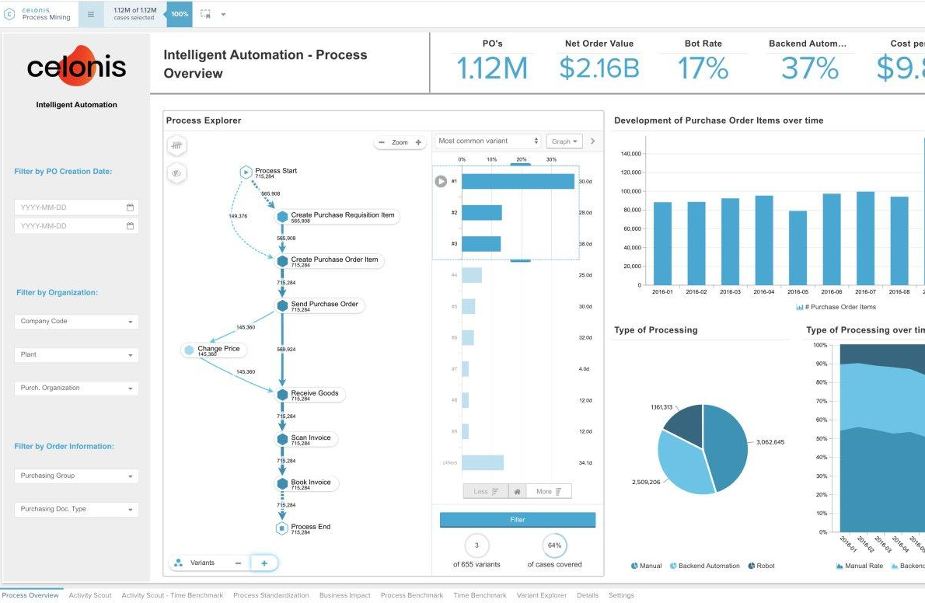
Introduction
Analyzes event logs to understand real-world process execution.
Identifies bottlenecks, inefficiencies, and compliance risks.
Provides data-driven insights for process optimization and improvement.
Empowers organizations to achieve operational excellence and cost savings.

Slide 5
Introduction
Process Explorer, Variant Explorer
Conformance Checking
Simulates changes to processes to predict their impact on performance and identify potential risks.
Performance Analysis
Conducts root cause analysis by Identifying deviations, Analyzing variants, Correlating data

Slide 6
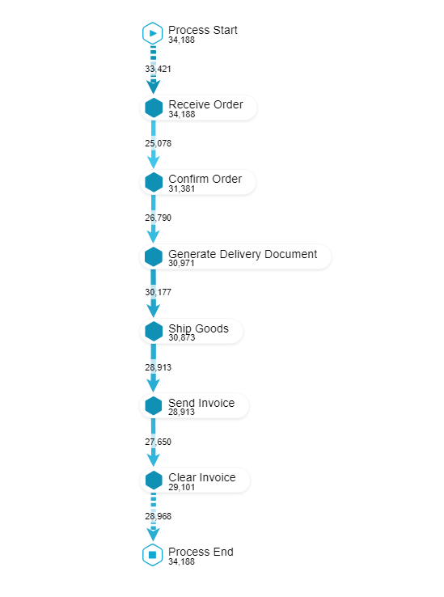
Ideal Process Flow
Ideal case represents the most optimal or desired pathway that a process should follow to achieve the best possible outcome.
It serves as a reference model for the process, showing the ideal sequence of activities and the expected flow from start to finish.
It involves promptly receiving and confirming orders, generating accurate delivery documents, shipping goods on time, sending invoices promptly, and ensuring timely invoice clearance.
Here process follows a predefined, clear, and optimized flow with minimal or no deviations.

Slide 7
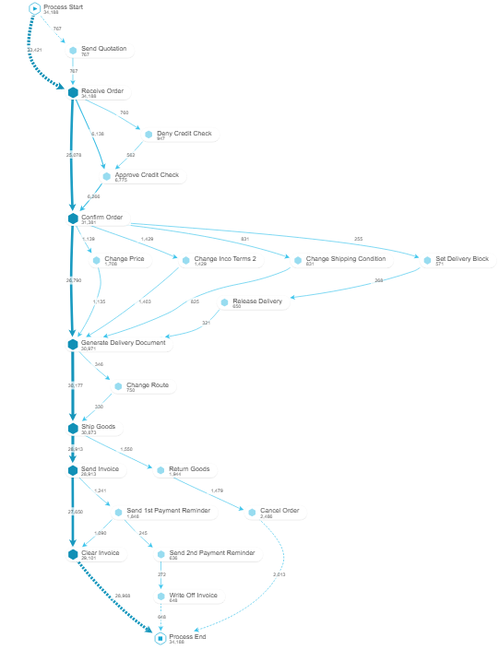
Deviation Analysis
In reality, deviations from the ideal case are common and can occur due to various factors such as human errors, system glitches, and unforeseen events.
These deviations can lead to inefficiencies, delays, errors, and increased costs.
Addressing these deviations allows businesses to move closer to the ideal case, ensuring better process performance and enhanced customer satisfaction.

Slide 8
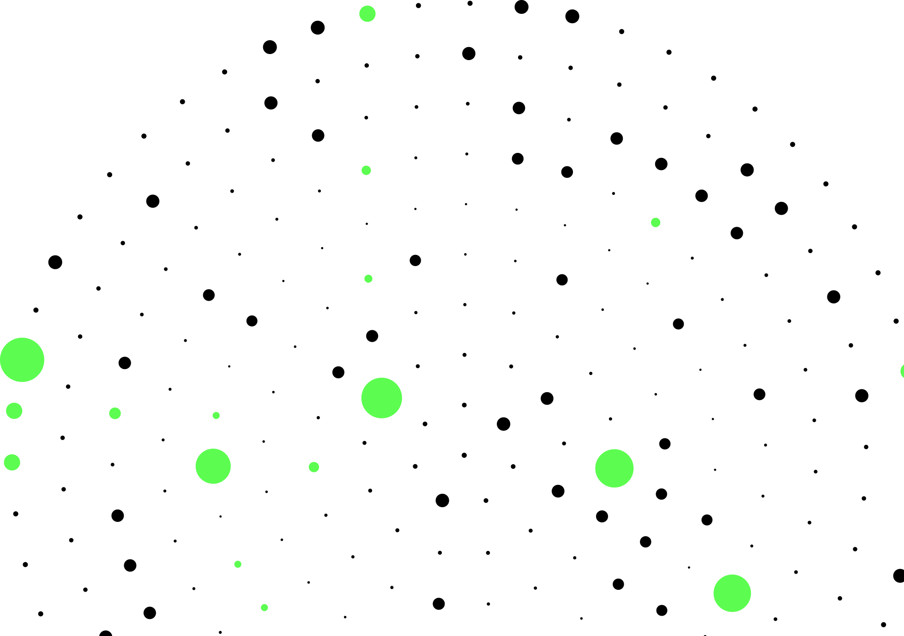
Process Overview
12
5386
845

Slide 9
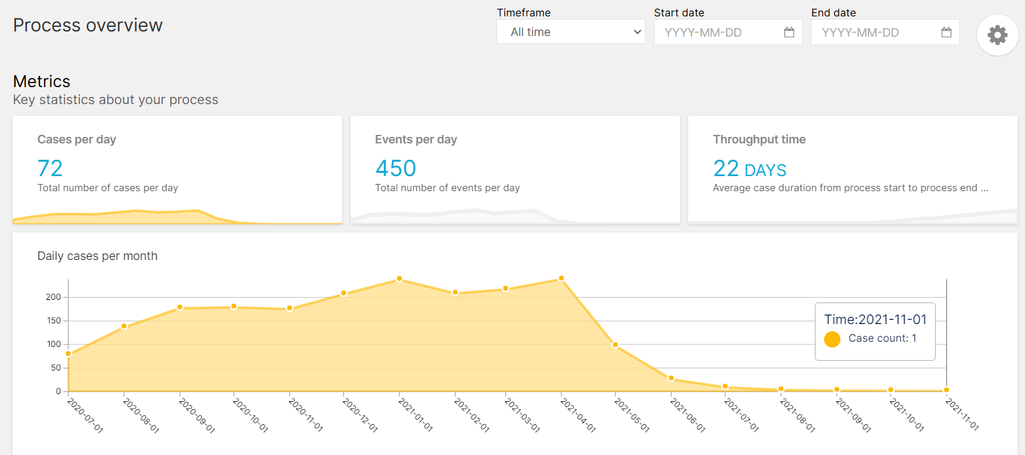
Process Overview
Our order-to-cash process handles about 72 cases daily
We see seasonal peaks in case volume during January and April
Our goal is to reduce the average processing time

Slide 10
Deviation Analysis
12
5386
845

Slide 11
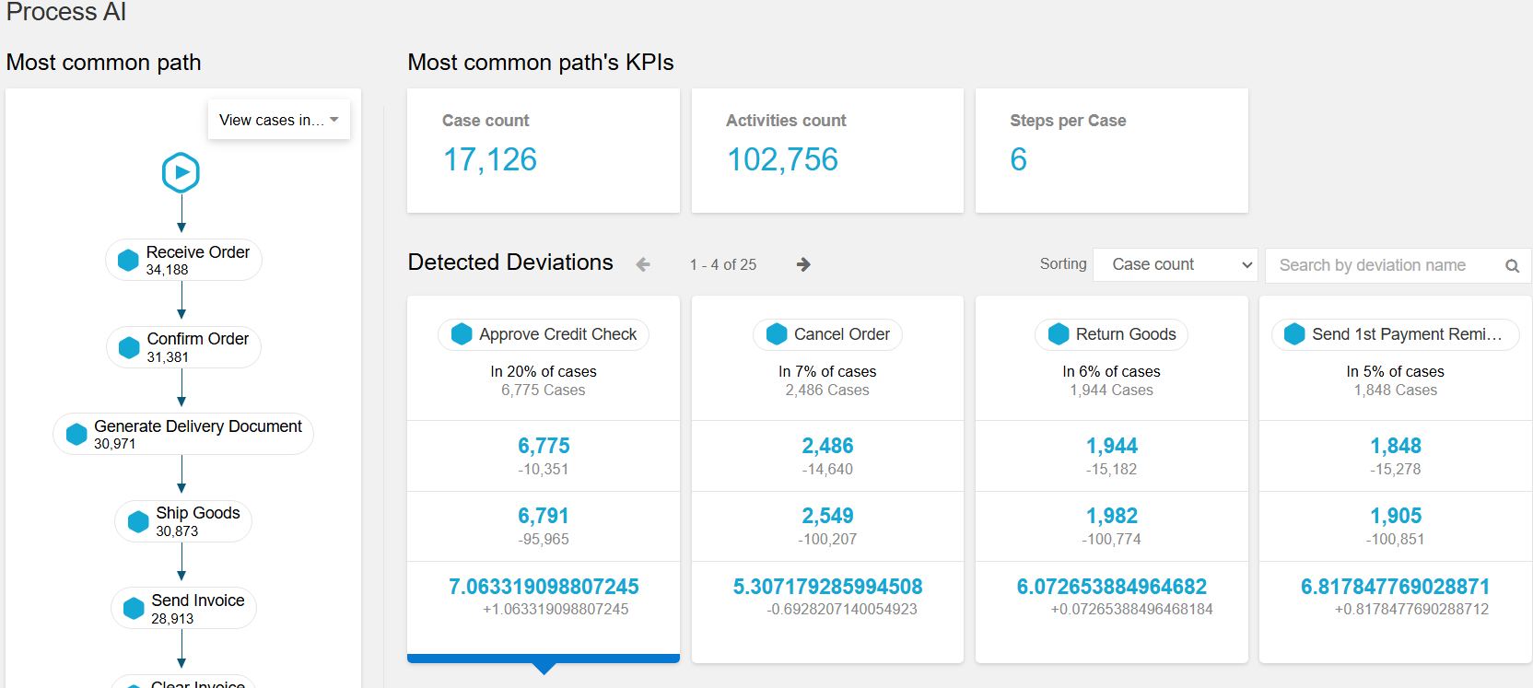
This visualization shows the most common path in our order-to-cash process, with a total of 17,126 cases.
The process involves 6 steps on average, with "Receive Order" and "Confirm Order" being the most frequent starting points.
Along the way, there are potential deviations like "Approve Credit Check," "Cancel Order," and "Return Goods."

Slide 12
Root Cause Analysis
12
5386
845

Slide 13
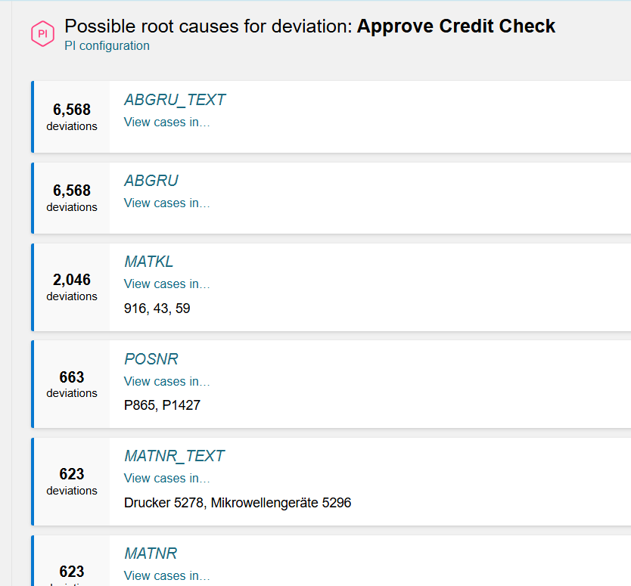
Approve Credit Check
This visualization shows the distribution of "Approve Credit Checks" across different customers.
First field represents “cancellation reasons” associated with cases requiring credit check approvals, indicating specific reasons
Second field represents material groups, showing that certain product categories tend to have higher occurrences of credit check approvals(916,43,59, )
Position numbers within sales orders that require credit check approvals, possibly due to specific items or quantities in those positions that present higher credit risk.

Slide 14
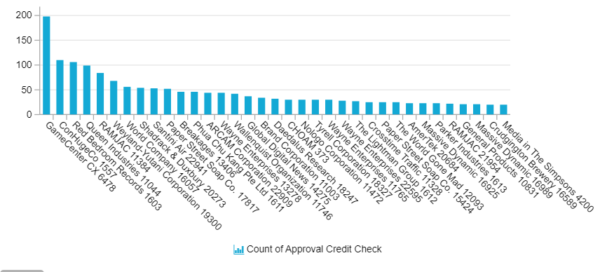
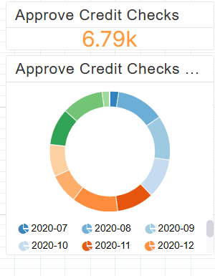
MATNR_TEXT lists specific product names with frequent credit check approvals, helping identify which products are more likely to need credit checks. i.e Printer and Microwave Oven.
NETWR_CONVERTED : Higher-value orders are more often subject to credit checks, likely due to the increased financial risk.

Slide 15
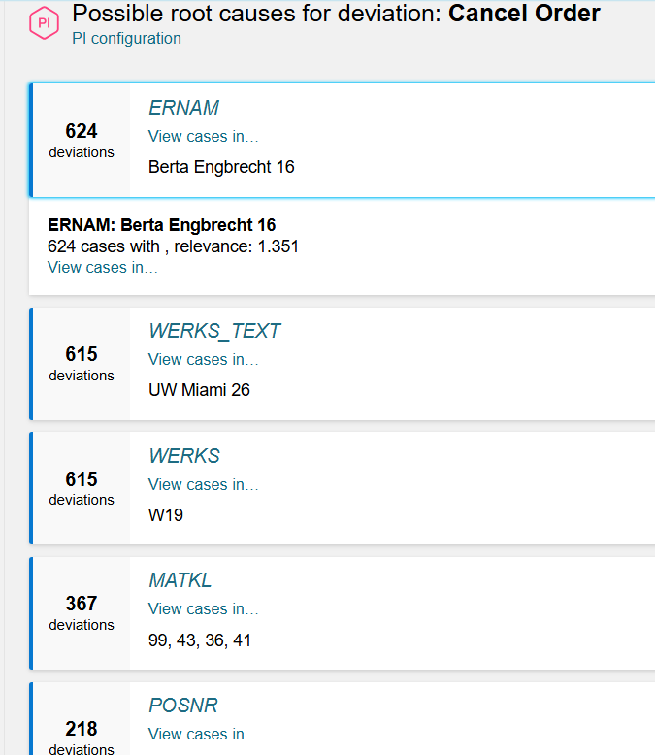
Cancel Orders
"Berta Engbrecht" appears in 624 deviations, indicating that this user might be a common factor in order cancellations.
Deviations show plants like "UW Miami 26," belongs to W19 suggesting a location-based factor.
Shows specific material groups such as "99, 43, 36, 41," suggesting that certain types of materials may be associated with the cancellations.
Deviations with certain Item numbers ("P865," "P51") might indicate that these specific items in orders tend to get canceled more frequently.

Slide 16
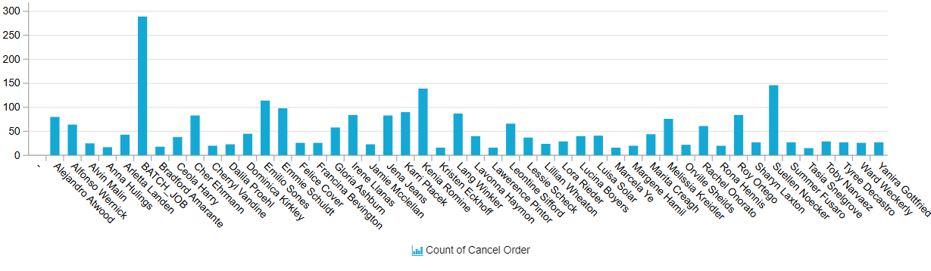
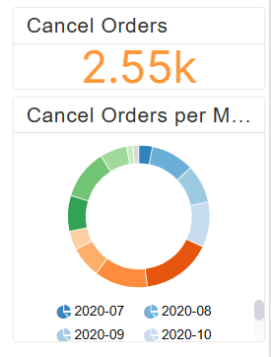
Net Order Value may suggest that orders with specific value thresholds are more likely to be canceled, perhaps due to financial or logistical constraints.
Chart represents the name of the users who has cancelled the orders.

Slide 17
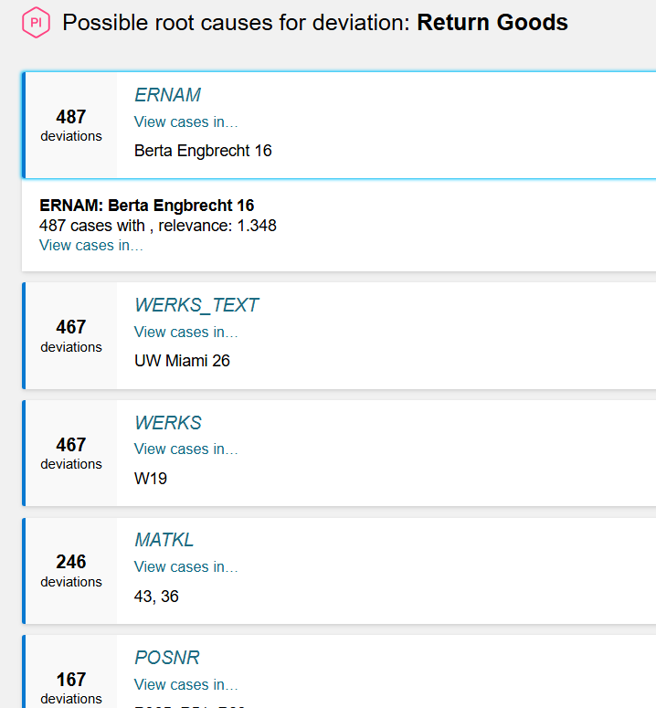
Return Goods
A specific user (e.g., "Berta Engbrecht") is linked to many returns, suggesting potential handling or quality issues related to certain order creators.
Locations, like "UW Miami" and plant "W19," show high return rates, indicating issues possibly tied to specific facilities.
Certain material groups (e.g., 43, 36) have higher returns, possibly due to quality or suitability issues in these product categories.
Specific order Item Num (e.g., "P865," "P51") see frequent returns, potentially highlighting issues with certain items in these positions.

Slide 18
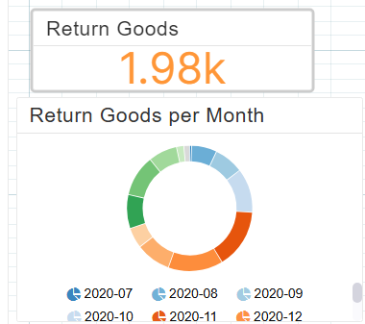
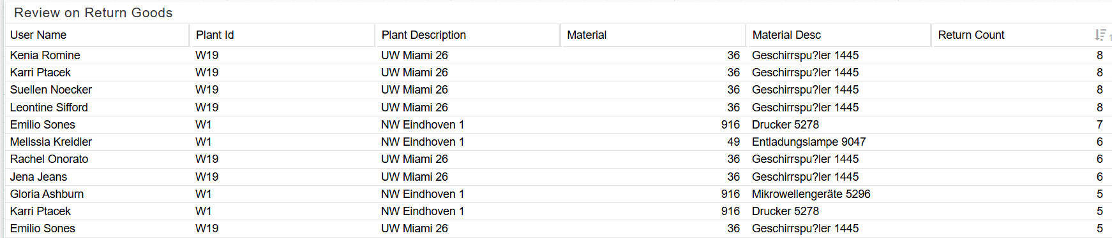
Certain order values (e.g., "37") are associated with higher returns, which may reflect price or quality expectations at certain price points.
Specific products, like "Dishwasher 1445" or code "Microwave Oven M5154," are returned often, suggesting these items may have quality or satisfaction issues.

Slide 19
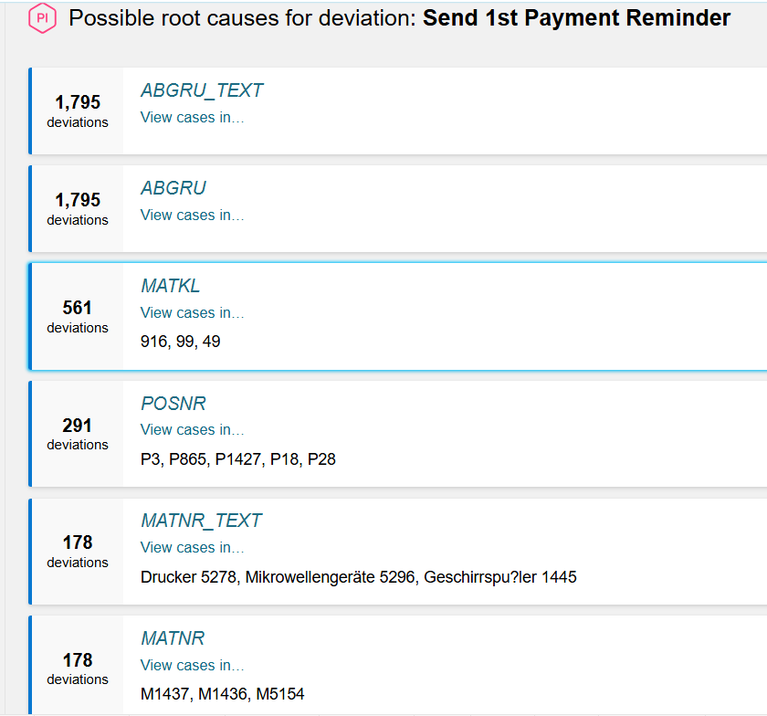
Send 1st Payment Reminder
Rejection reasons linked to payment reminders indicate that specific rejection codes may lead to delayed payments requiring reminders.
Certain material groups (e.g., codes 916, 99, 49) show a high occurrence of payment reminders, suggesting possible payment delays for specific product categories.
Specific order positions (e.g., "P3," "P865") are frequently associated with reminders, possibly due to items in these positions having payment delays.

Slide 20
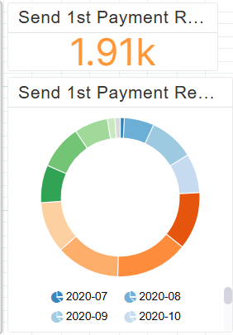
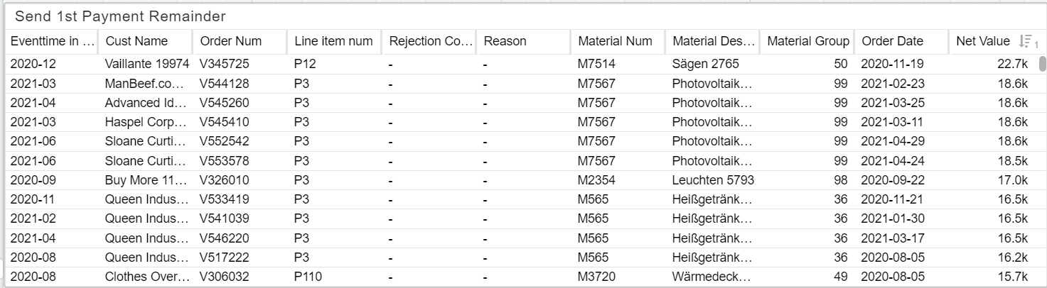
+
Product descriptions (e.g., "Printer 5278," "Microwave Ovens 5296") show frequent reminders, pointing to specific products with delayed payments.
Certain order values (e.g., "37") are associated with payment delays, suggesting that orders of specific values may often require payment reminders.

Slide 21
Rework
12
5386
845

Slide 22
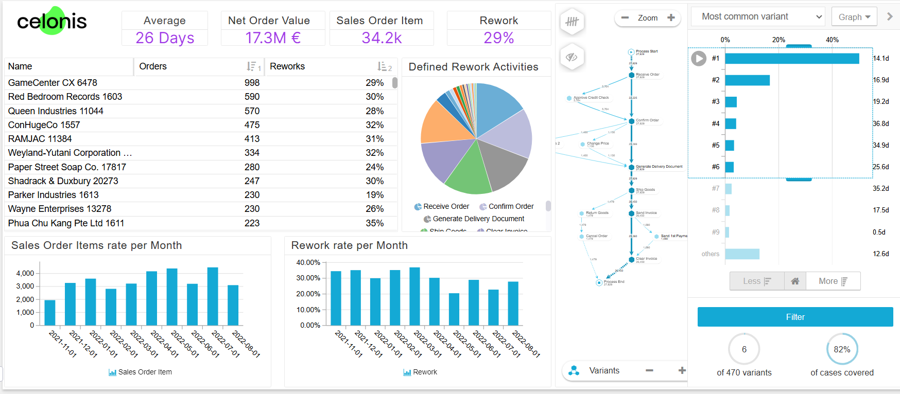

Slide 23
"Rework" refers to the activities within a business process that need to be repeated or corrected after the initial attempt. Rework is typically undesirable as it indicates inefficiencies, potential quality issues, or delays. By analyzing rework activities, organizations can identify areas where improvements are needed to enhance efficiency, reduce cycle time, and improve overall process quality.
Rework Rate (29%): Indicates the percentage of orders requiring rework. A high rework rate suggests inefficiencies, quality issues, or complex processes that may need to be optimized.
Top Customers Table: Shows the customers with the most orders and rework percentages. This table can help identify key customers who may be causing inefficiencies or need additional support.
The pie chart in this dashboard provides a breakdown of the different types of rework activities occurring in the process.
Receive Order: This rework reflects issues in order intake, such as data entry errors, incomplete information, or unclear requests that need follow-up. High levels here suggest inefficiencies in the initial order handling process.
Confirm Order: Rework here indicates the need to revalidate orders due to discrepancies or unclear details. Frequent rework suggests communication gaps or inconsistencies in order specifications.

Slide 24
Customers Overview
12
5386
845

Slide 25
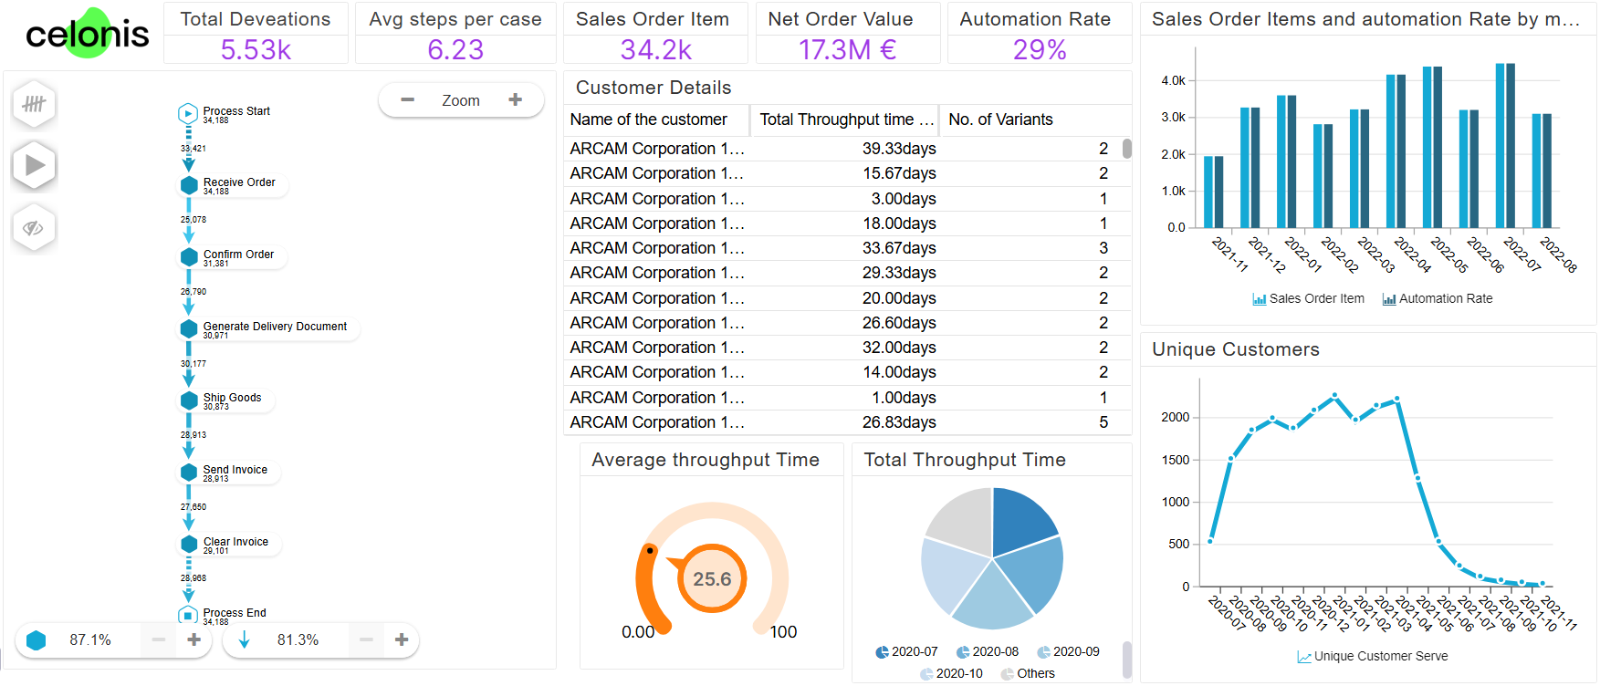

Slide 26
Throughput Time: Measures the total time taken to complete an order.
Total Deviations: Indicates the number of instances where the process deviated from the standard path.
Steps per Case: Shows the average number of steps required to process an order.
Automation Rate : Reduces manual intervention, leading to faster processing times. Minimizes human error, ensuring data accuracy and Improves customer satisfaction through faster order processing.
The column chart illustrates the distribution of automation rates across different sales order items. A higher automation rate indicates a more efficient and streamlined process. The chart can be used to identify areas where automation can be further implemented to improve overall O2C performance.

Slide 27
Company and Product Analysis
12
5386
845

Slide 28
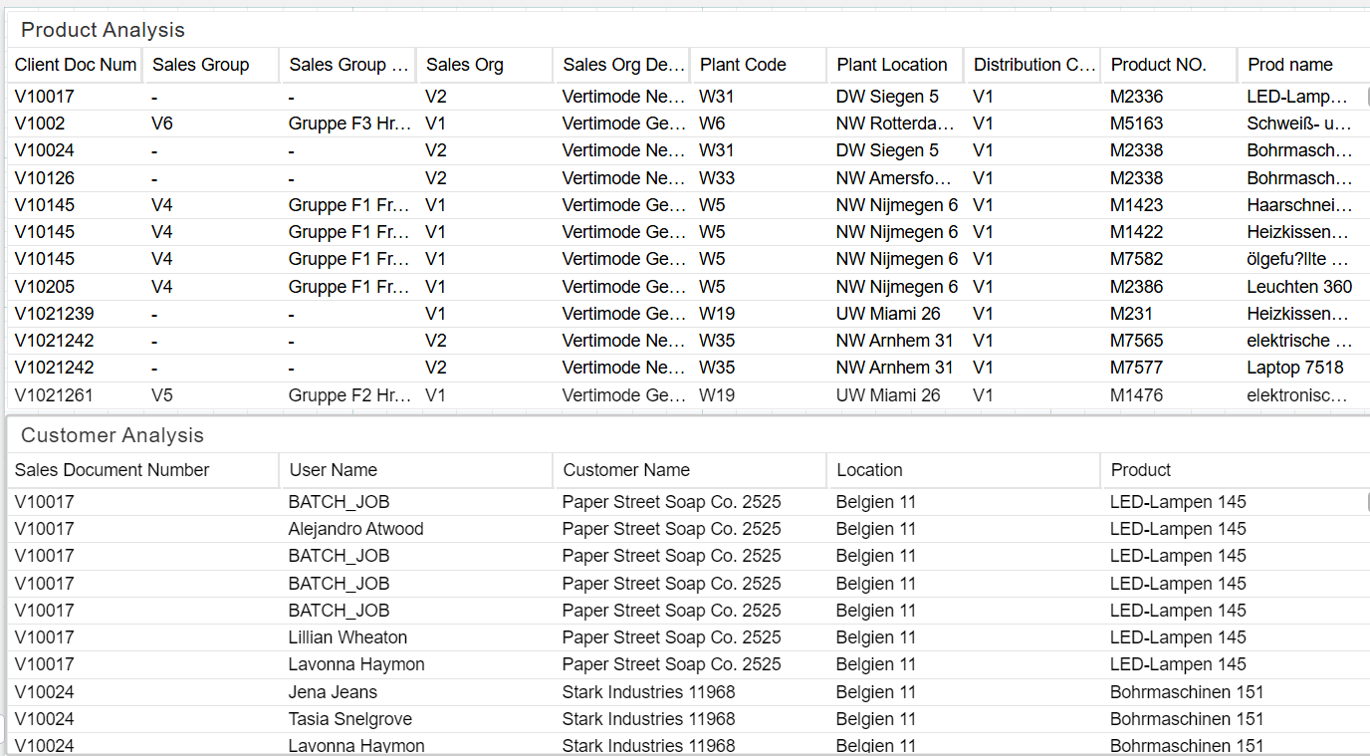

Slide 29
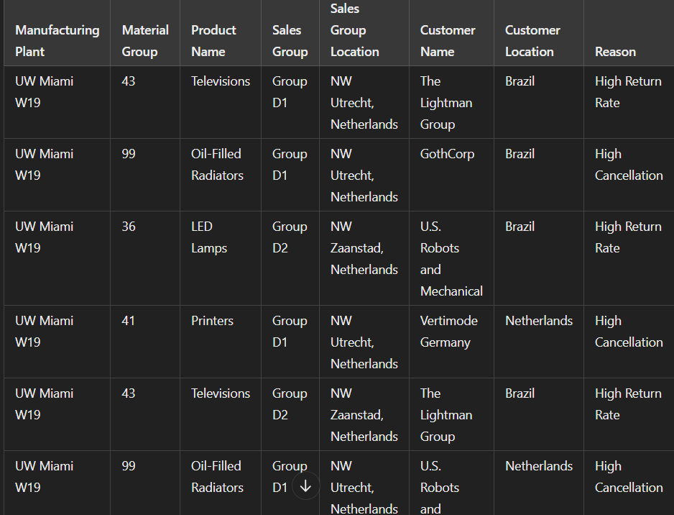
Company and Product Analysis
12

Slide 30
The high return and cancellation rates from the UW Miami W19 plant stem from quality control issues and logistical delays in delivering products, particularly in electronics and household items. Products in material groups 43 (Televisions), 36 (LED Lamps), and 99 (Oil-Filled Radiators) have shown recurring dissatisfaction among customers, leading to returns.
Additionally, the geographical challenges of fulfilling orders from different locations exacerbate these issues.
These factors contribute to misalignment between customer expectations and product performance, driving up return rates.

Slide 31
Conformance Checks
12
5386
845

Slide 32
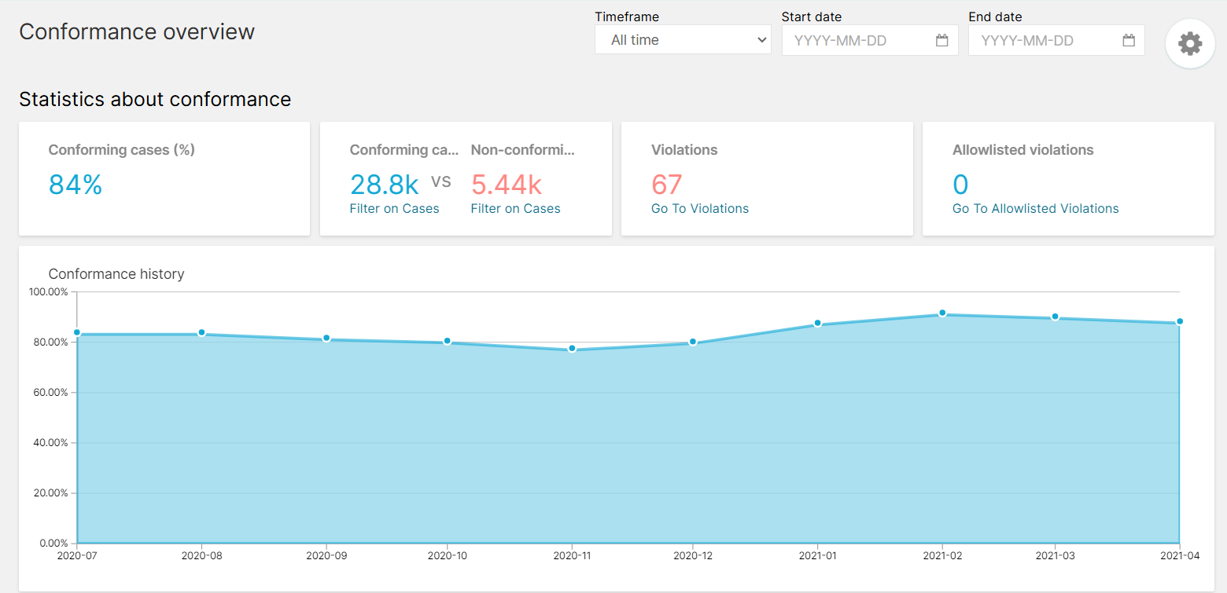

Slide 33
conformance analysis is a powerful technique to assess how well your actual process execution aligns with your ideal process model.
In the image, 84% of cases were conforming, which means they adhered to the defined process.
Conforming vs. Non-Conforming Cases: This section provides a breakdown of the number of cases that were conforming and non-conforming. It helps you visualize the extent of deviations from the ideal process.
Violations: This metric shows the number of specific violations detected in the process. These violations represent instances where the actual process deviated from the expected flow.
Allowlisted Violations: These are violations that have been intentionally allowed or are considered acceptable deviations from the standard process.

Slide 34
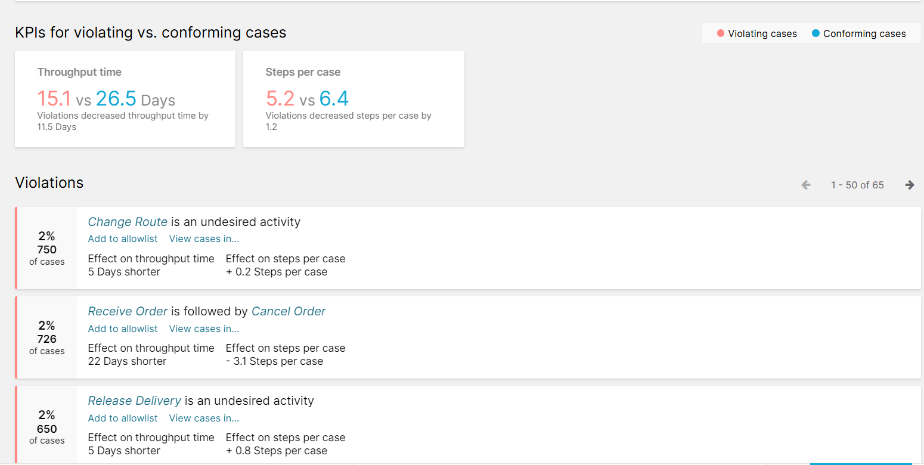

Slide 35
Throughput Time: Conforming cases have more steps per case (6.4) than violating cases (5.2). This indicates that deviations might involve fewer steps, possibly due to shortcuts or workarounds.
Steps per Case : Conforming cases have more steps per case (6.4) than violating cases (5.2). This indicates that deviations might involve fewer steps, possibly due to shortcuts or workarounds.
Violations :-
Change Route : This undesired activity occurs in 2% of cases and can lead to a 5-day reduction in throughput time and a slight increase in steps per case.
Receive Order Followed by Cancel Order: This violation also occurs in 2% of cases and significantly reduces throughput time by 22 days while also reducing the number of steps per case.
Release Delivery: This undesired activity happens in 2% of cases and can lead to a 5-day reduction in throughput time but a slight increase in steps per case.

Slide 36
Results and Conclusions
12
5386
845

Slide 37
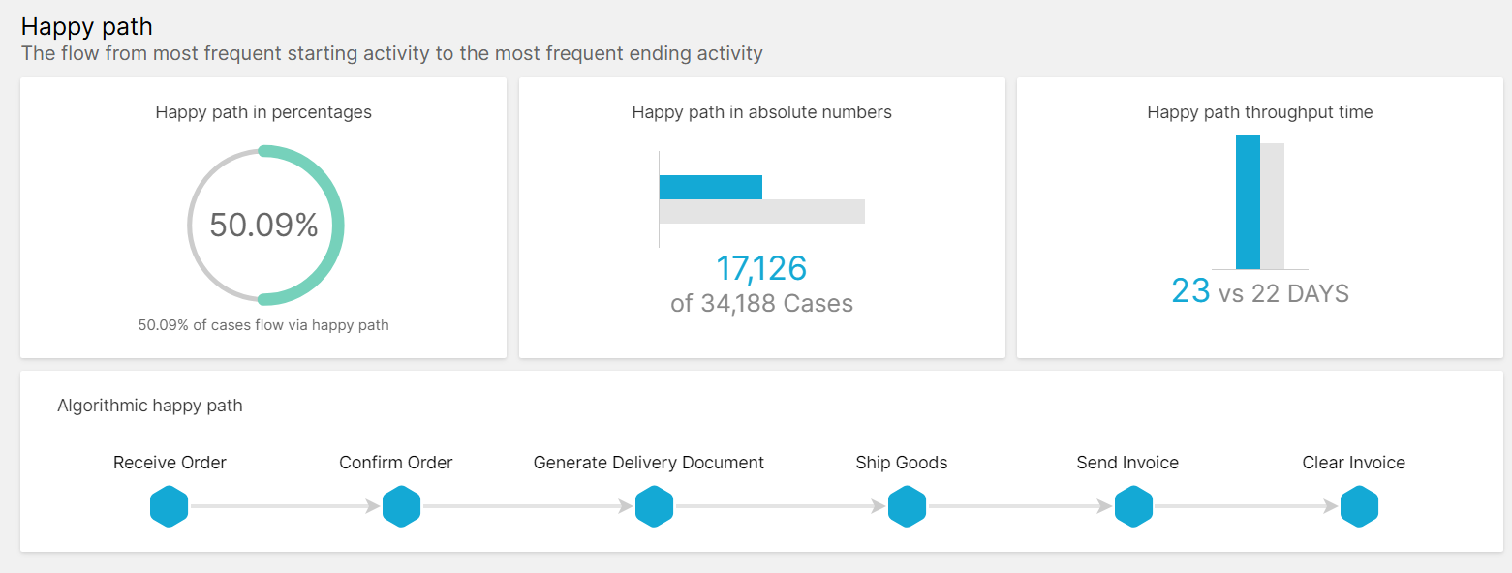

Slide 38
Conclusions Drawn
Ensure proper handling of the Approve Credit Check step to reduce delays
Consider adding more distribution channels to reduce delays and potential issues.
Inspect materials with high cancellation or return rates to improve quality. Plant : W19, operating from 3 locations UW Miami, NW Zaanstad, NW Utrecht needs to be inspected very well and their quality has to be checked for materials like Printers, LED Lamps, Televisions, Oil-Filled Radiators, Dishwashers, Televisions.
Gather customer opinions before shipping to avoid unnecessary shipping costs.

Slide 39
Thank you.

